Slide 1

Introduction to Unsupervised Learning Understanding Patterns and Structures in Data
Kyle Territo
CHE 4230

Slide 2
Learning Objectives
Define unsupervised learning and its importance
Differentiate between supervised and unsupervised learning
Explore key unsupervised learning techniques: clustering and dimensionality reduction
Understand practical applications of unsupervised learning

Slide 3
Review:
Open up the command terminal on your pc (not in VSCODE)
Get comfortable with navigating to folders through the cmd line
cd <path>
cd ..
cd \
cls
Ctrl + C
Navigate to a folder where you store your repositories..
*move up a level
*go to root directory
*clear terminal
*interrupt terminal

Slide 4
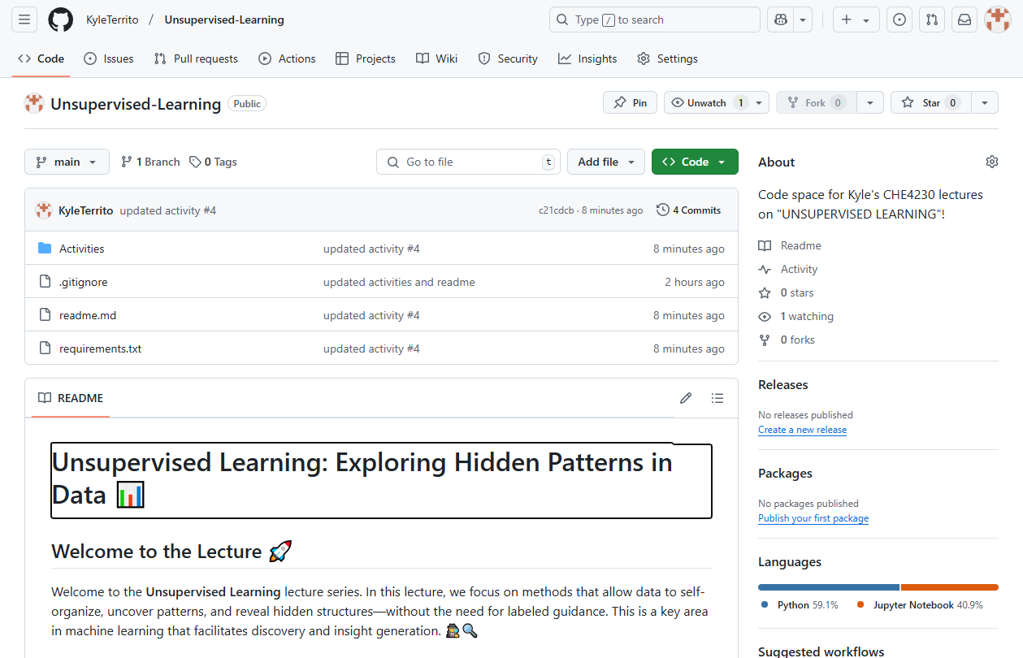
Clone the following repo here…
We’ll use this folder for our unsupervised learning lectures.
https://github.com/KyleTerrito/Unsupervised-Learning.git

Slide 5
Activity #1 “Intro”:
In many real-world situations, data does not come with clear labels or categories.
How do we uncover hidden structures, patterns, or groupings in such datasets?
Take a look at the provided dataset “Pyrolysis” (open in python or excel).
What meaningful insights, trends, or groupings can you find in this data by inspecting it manually?

Slide 6
Activity (Discussion):
How easy or hard was it to find meaningful insights?
Could you find patterns or structures in the data.
Discuss any challenges you faced, such as data complexity, volume, or lack of labels.
What methods did you use to explore the data?
What if the dataset had even more features or rows?
What is there was a way to automate this exploration without manual effort?
Unsupervised Learning!!

Slide 7
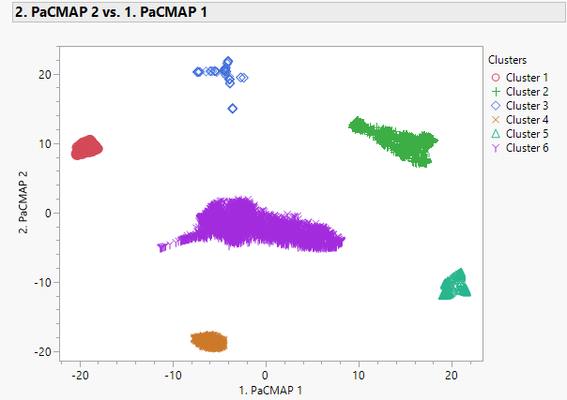
Activity (Discussion):

Slide 8
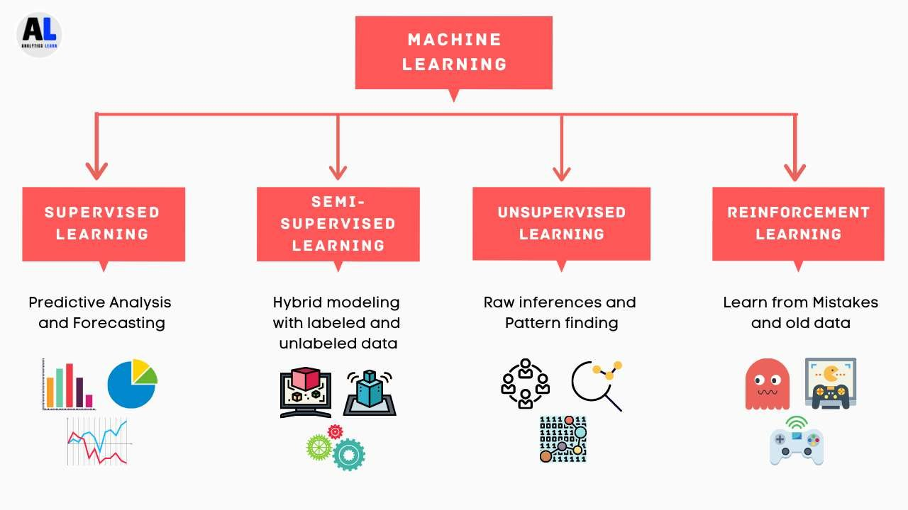
Machine Learning

Slide 9
What is unsupervised learning?
Definition: a type of machine learning that identifies patterns and structures in data without labelled outcomes
Key idea: the algorithm infers a function to describe hidden structures in data
Comparison with Supervised Learning:
Supervised Learning: Input → Output (labels provided)
Unsupervised Learning: Input → Hidden Structure (no initial labels)

Slide 10
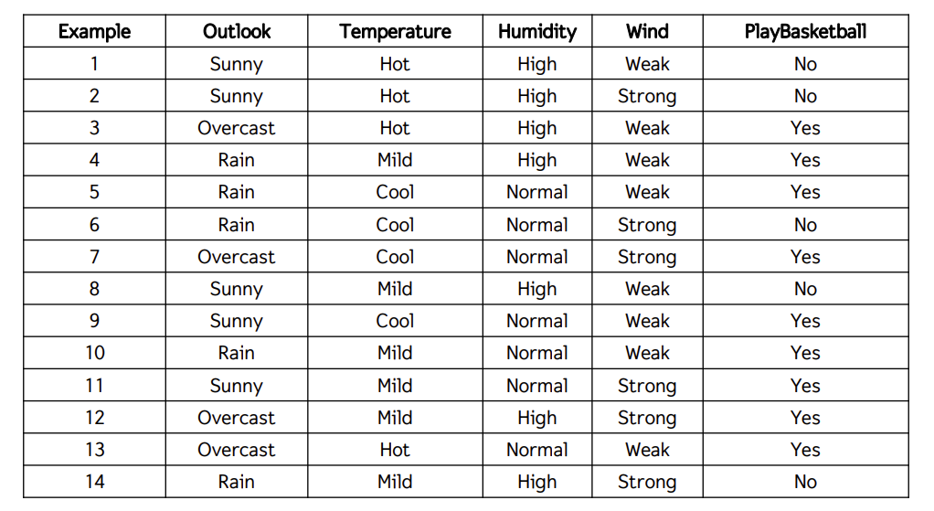
What are labels?

Slide 11


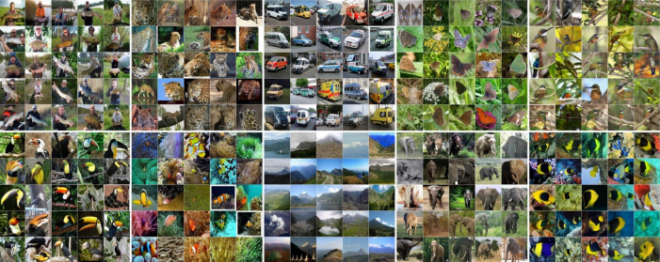
Key Applications

Slide 12


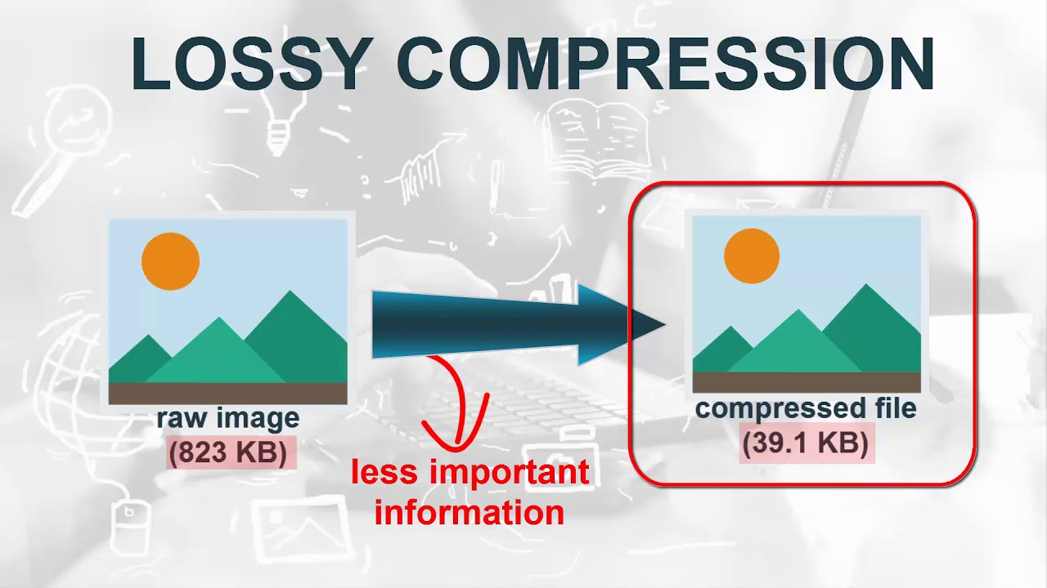
Key Applications
Market segmentation
Image/ video compression
Anomaly detection
Customer recommendation systems
Speech and audio analysis

Slide 13
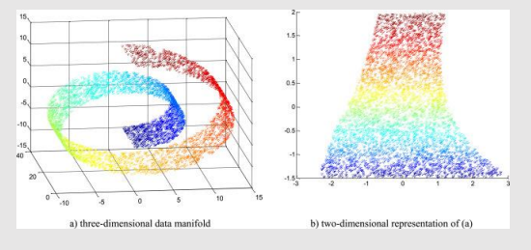
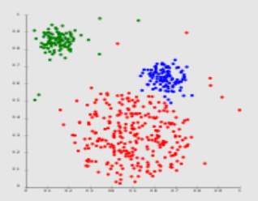
Types of Unsupervised Learning
Dimensionality Reduction (DR)
Reducing the number of features while retaining essential information
Clustering
Organizing data into groups based on similarity
Self-Organizing Maps (SOMs)
Maps high-dimensional data onto a low-dimensional grid while preserving topological relationships

Slide 14
Dimensionality Reduction
Definition: Simplifying data by reducing its dimensions
Popular techniques:
PCA (Principal Component Analysis)
t-SNE (t-Distributed Stochastic Neighbor Embedding)
UMAP (Uniform Manifold Approximation and Projection)
PaCMAP (Pairwise Controlled Manifold Approximation Projection)

Slide 15
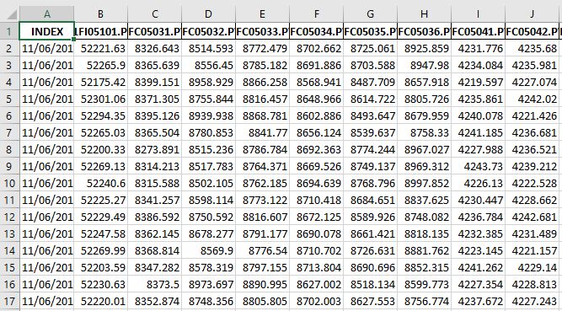
Goal of dimensionality reduction…
2 features ?
27 features…

Slide 16
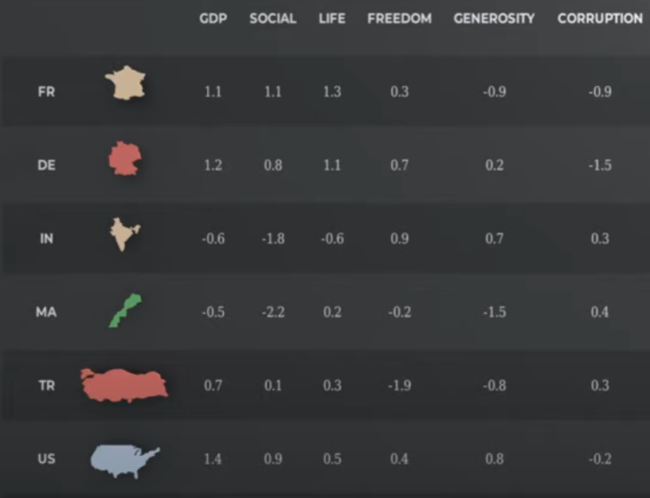
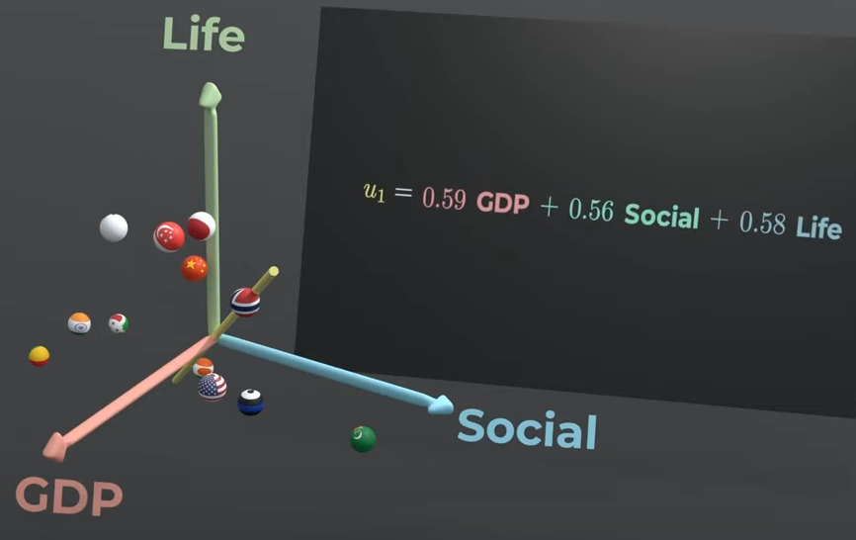
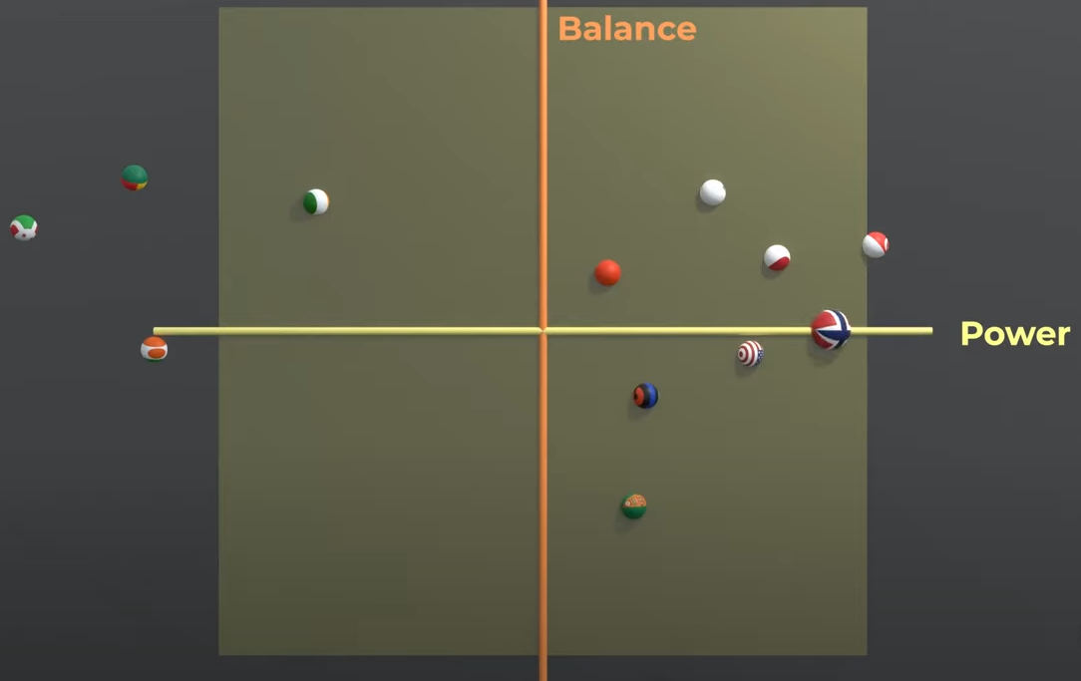
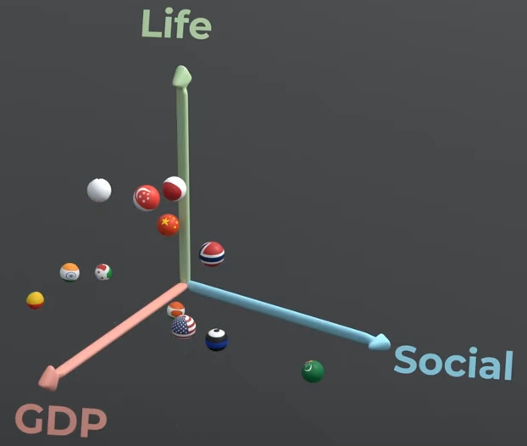
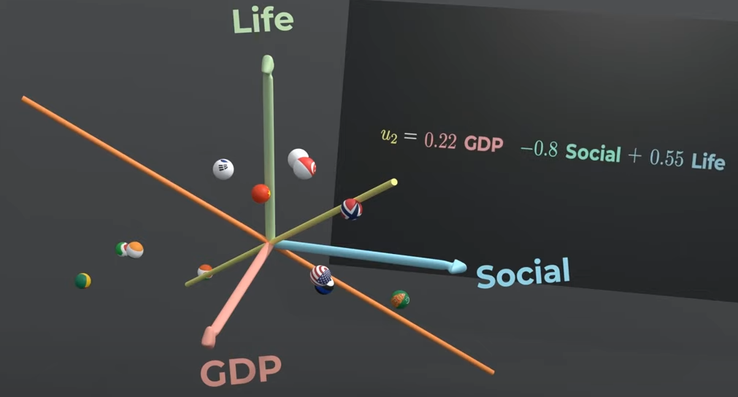
Dimensionality Reduction
Principal Component Analysis (PCA) - YouTube

Slide 17

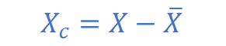
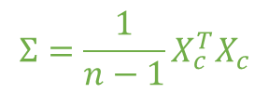
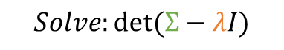
Principle Component Analysis (PCA)
Objective: Transform data into a smaller set of uncorrelated components
Steps:
Compute the mean-centered data
Compute the covariance matrix
Calculate eigenvectors and eigenvalues
Project data onto top eigen vectors
Pros: Effective for large datasets
Cons: Linear technique, may lose interpretability
$$X_{c}=X−\overline{X}$$
$$Σ=\frac{1}{n−1}X_{c}^{T}X_{c}$$
$$Σv=λv$$
$$Solve:det⁡(Σ−λI)$$

Slide 18
t-SNE
t-Distributed Stochastic Neighbor Embedding
How it works:
Converts pairwise similarities into probabilities in high dimensions
Maps these probabilities to a low-dimensional space while preserving relative similarities
Optimizes positions to minimize divergence between high and low dimensional distributions
Pros: excellent for capturing local structure and visualizing clusters
Cons: computationally intensive and non-deterministic (random)

Slide 19
UMAP
Uniform Manifold Approximation and Projection
How it works:
Constructs a weighted graph of nearest neighbors in high dimensions
Optimizes the graph layout in lower dimensions
Pros: Faster than t-SNE, preserves more global structure
Cons: Results sensitive to parameter tuning

Slide 20
PaCMAP
Pairwise Controlled Manifold Approximation and Projection
How it works:
Focusses on three types of point pairs: neighbors (local), mid-range, and distant points
Optimizes a weighted combination of pairwise distances
Pros: Balances local and global structure effectively
Cons: sensitivity to hyperparameters, computational cost

Slide 21
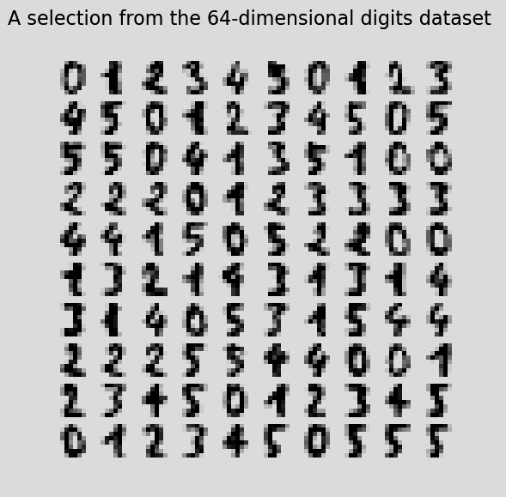
Activity #2 “Digits Data”
Go to Activity 2 in the folder. Here there is a code for DR methods.
This example uses a dataset called “Digits”
It contains 1,797 images of handwritten digits (8x8 pixels) flattened into 64 features

Slide 22
BUT, the data structure is preserved differently…
Types of data preservation:
Global Structure
Local Structure
Local-Global Structure
Global structure focuses on retaining the overall geometric relationships and variance patterns across the entire dataset.
Local structure maintains the proximity and relationships of nearby points in the reduced dimensional space
Type | Description | Example
LOCAL | long-distance relationships | PCA
GLOBAL | local neighborhoods | t-SNE
LOCAL-GLOBAL | balance between the two | UMAP, PaCMAP

Slide 23
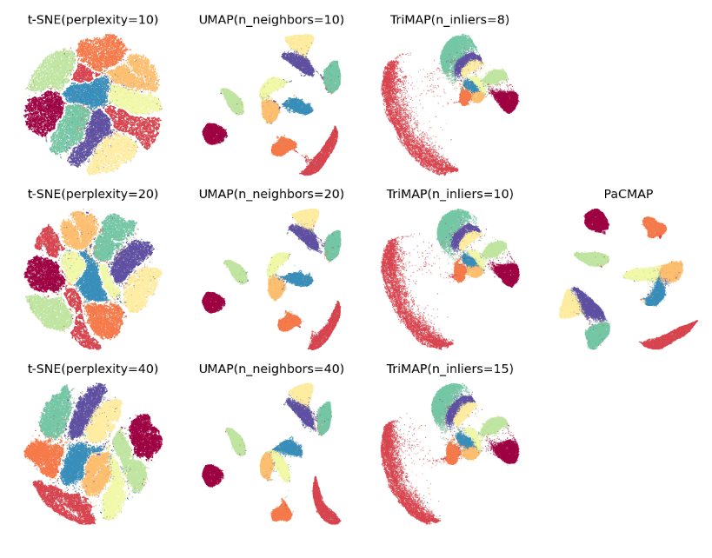
Benchmarks (MNIST)

Slide 24
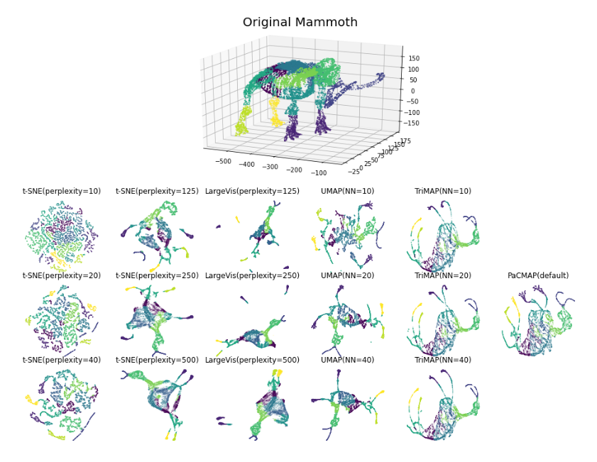
Benchmarks (Mammoth)

Slide 25
Clustering
Definition: Grouping similar data points together
Types:
Partition based
Hierarchical based
Density based
Popular algorithms:
K-Means (partition based)
Hierarchical Clustering (hierarchical based)
DBSCAN (density based)

Slide 26
K-Means
Definition: Grouping similar data points together using centroids
How it works:
Initialization- select k random points as initial centroids
Assignment step- assign each data point to the nearest centroid (based on Euclidean distance)
Update step- calculate the new centroid for each cluster (mean of all points in the cluster)
Repeat- iterate between assignment and update steps until centroids stabilize
Pros: simple, efficient
Cons: sensitive to initialization, have to select k number of clusters

Slide 27
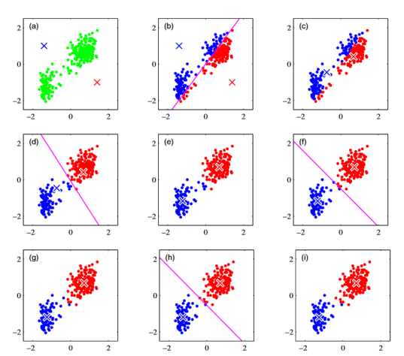
K-Means
After each iteration, the centroids move closer to the center of the expected clusters.
Points are reassigned each step until convergence.

Slide 28
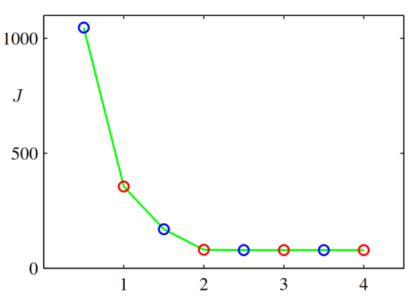
K-Means
Convergence is governed by an error function that maximizes the distance between clusters and minimizes distance of points within clusters.

Slide 29


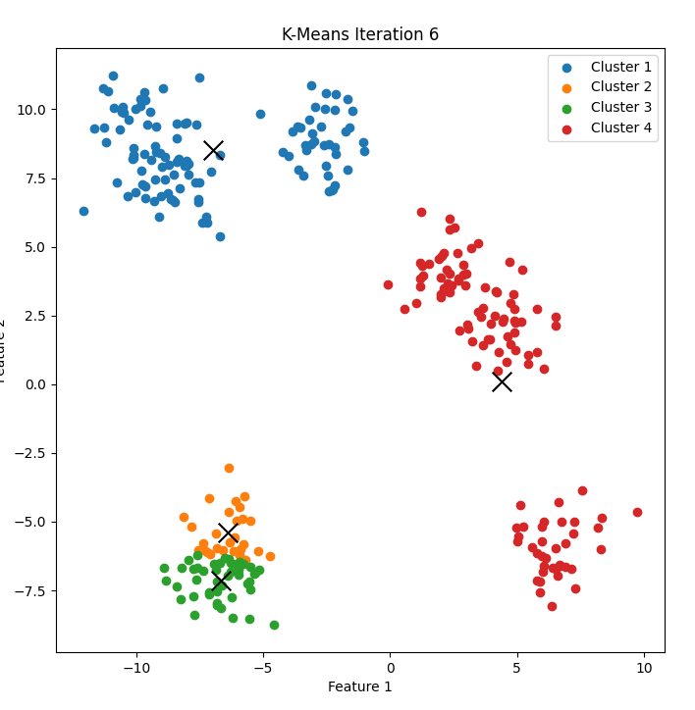
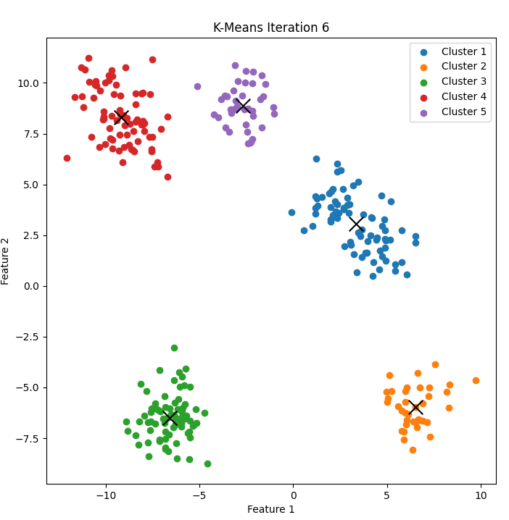
Activity #3 “K-Means Demo”

Slide 30
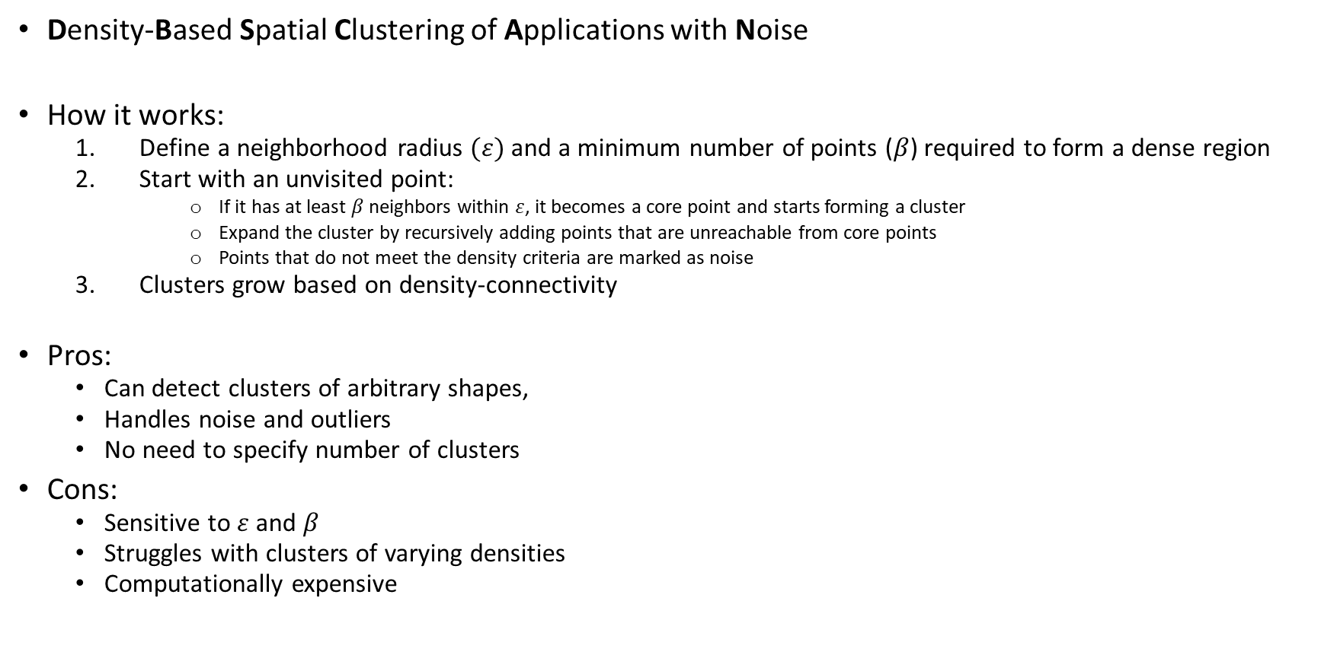
DBSCAN
Density-Based Spatial Clustering of Applications with Noise
How it works:
Define a neighborhood radius $(ε)$ and a minimum number of points ($β$) required to form a dense region
Start with an unvisited point:
If it has at least $β$ neighbors within $ε$, it becomes a core point and starts forming a cluster
Expand the cluster by recursively adding points that are unreachable from core points
Points that do not meet the density criteria are marked as noise
Clusters grow based on density-connectivity
Pros:
Can detect clusters of arbitrary shapes,
Handles noise and outliers
No need to specify number of clusters
Cons:
Sensitive to $ε$ and $β$
Struggles with clusters of varying densities
Computationally expensive

Slide 31
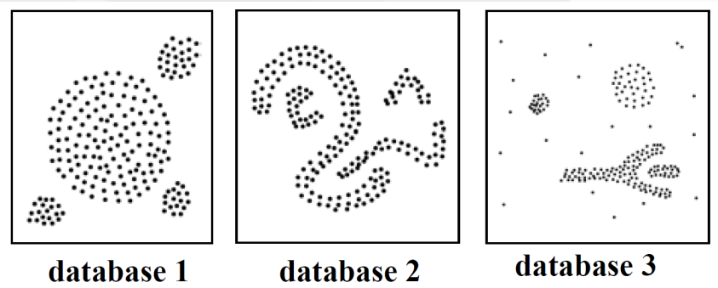
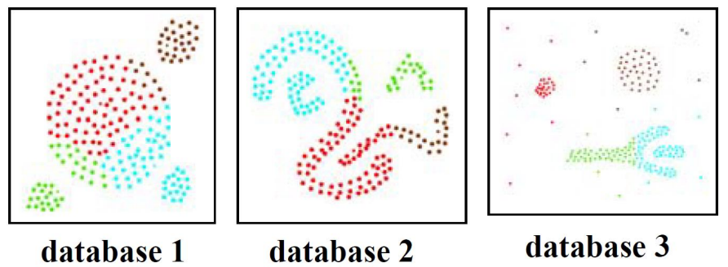
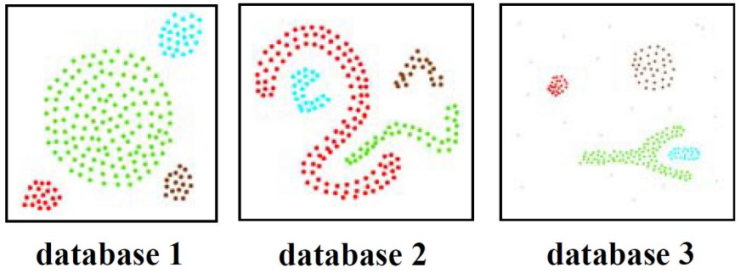
Centroid-based vs Density-based

Slide 32
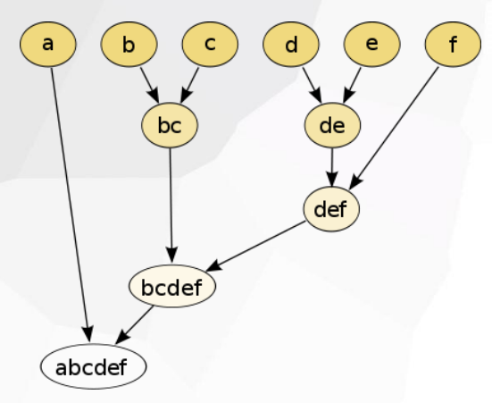
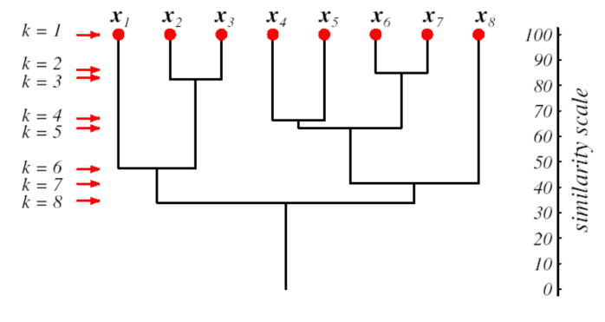
Hierarchical Clustering
Types:
Agglomerative (bottom-up)
Divisive (top-down)
Key idea: Build a tree (dendrogram) based on associations between group members. Determine number of clusters based on group associations.
Pros: Does not require specifying k
Cons: Computationally expensive

Slide 33
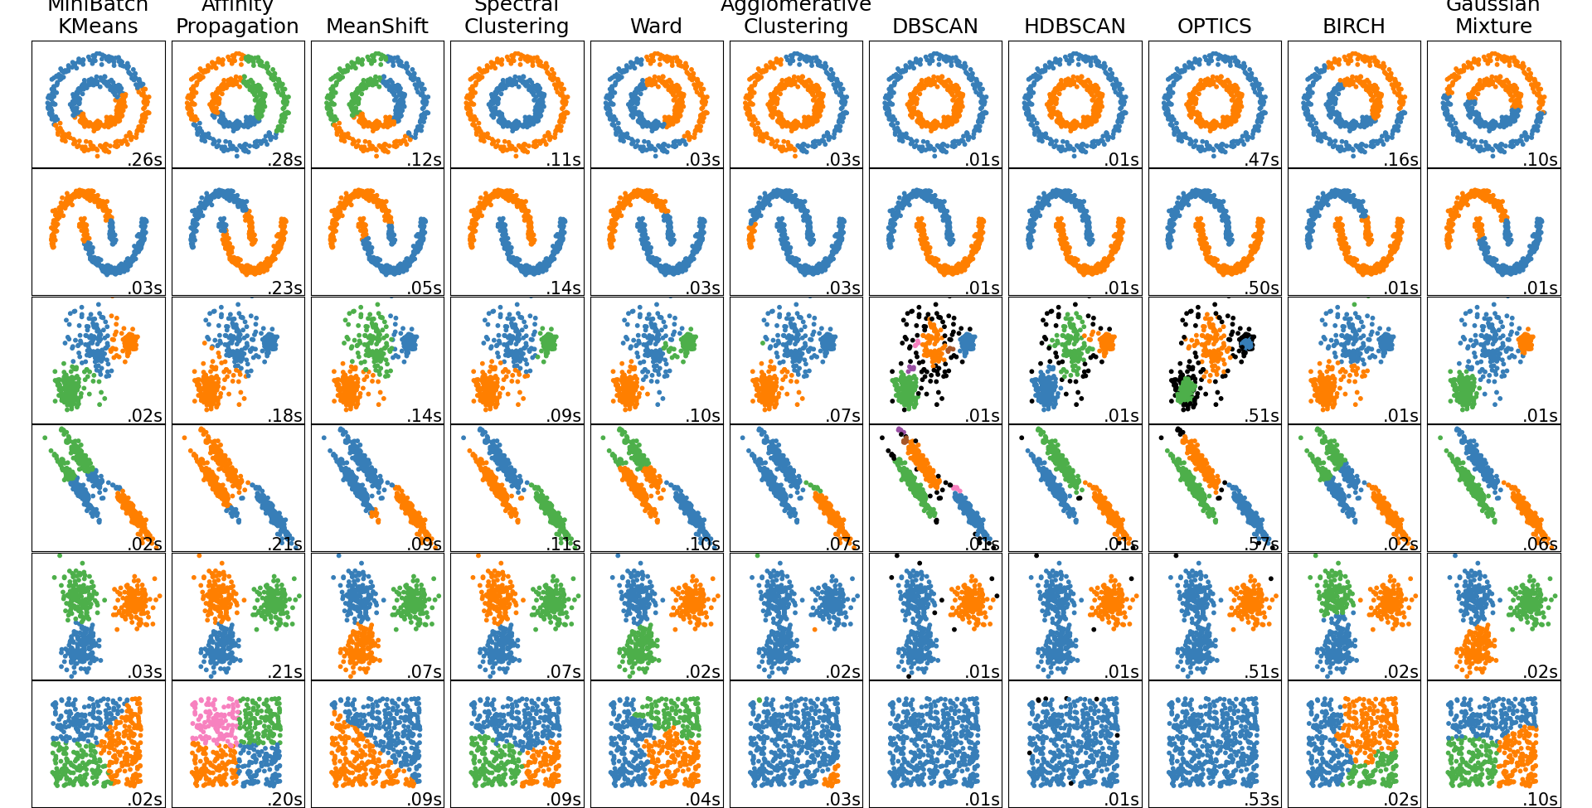
Clustering Examples

Slide 34
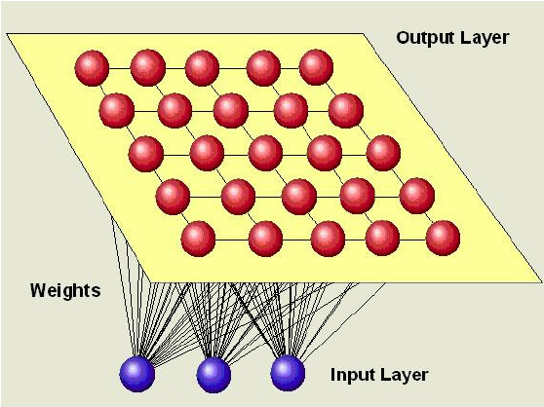
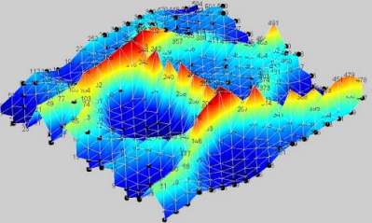
Self-Organizing Maps (SOMs)
What It Is: SOMs are a type of unsupervised neural network that organize and simplify complex, high-dimensional data into a 2D grid, where similar data points are placed closer together.
How It Works: SOMs identify the grid point (node) most similar to a data point, called the Best Matching Unit (BMU). Then, the BMU and its neighbors are adjusted to resemble the data point more closely, gradually shaping the grid to reflect the data's structure.
Why It’s Useful: SOMs preserve topological relationships, meaning similar data points are mapped near each other on the grid. This makes it easy to visualize patterns, clusters, and relationships in data while retaining the original structure and similarities.

Slide 35
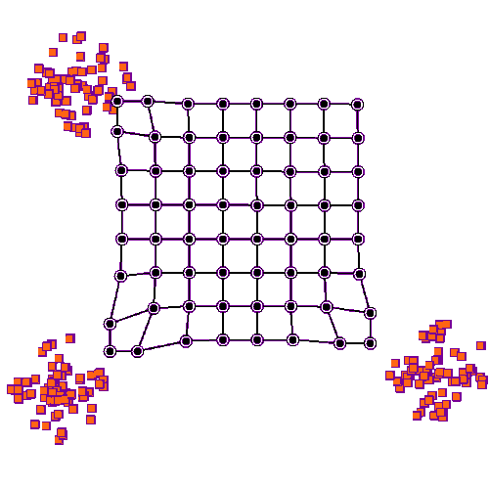
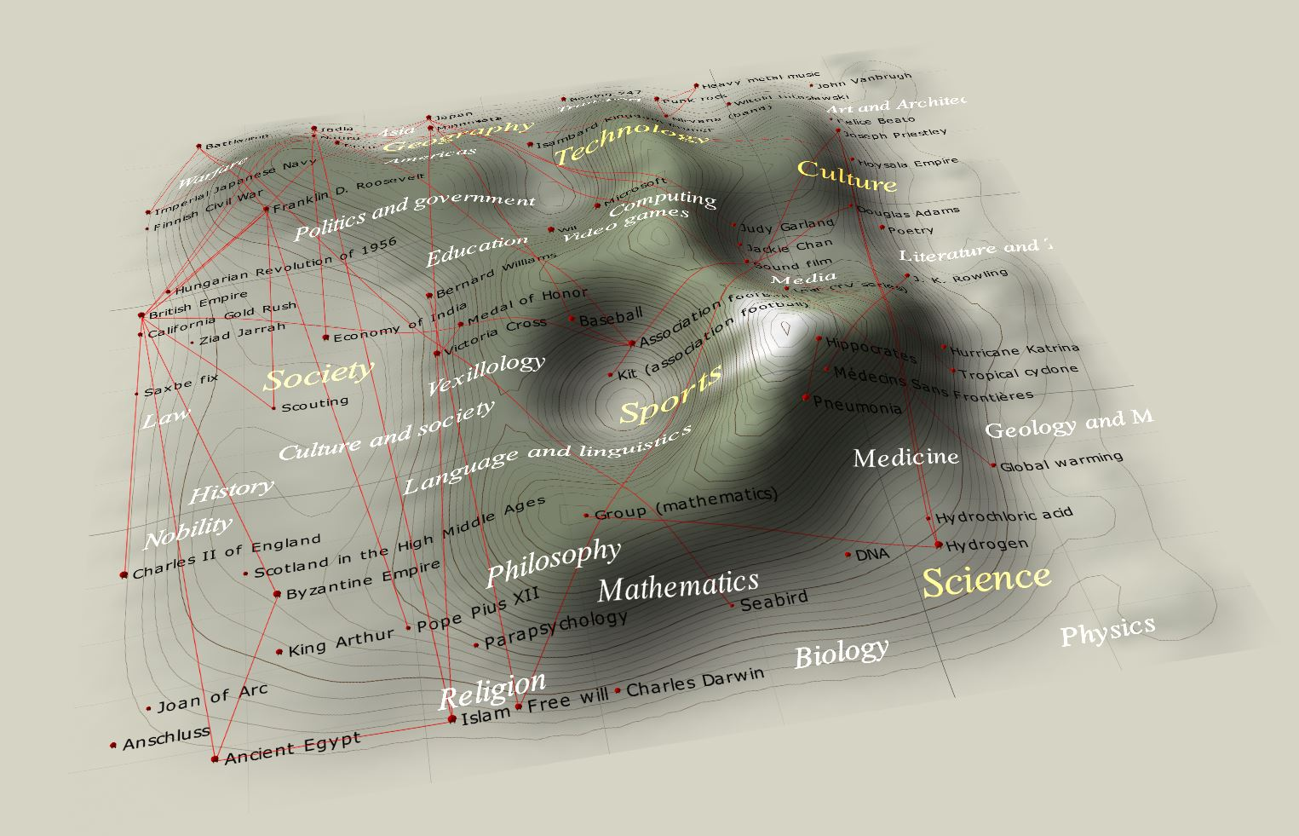
SOMs

Slide 36
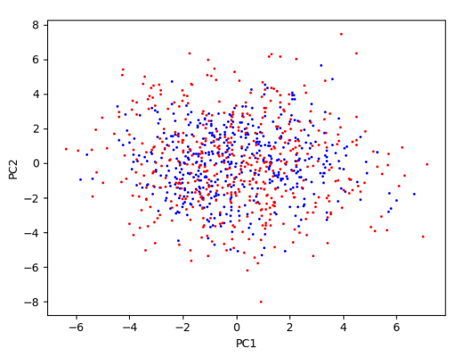
Challenges in Unsupervised Learning
Lack of labeled data for validation
How can the results be validated?
Choice of hyperparameters
Interpretability of results
Computational complexity
Does this mean anything?

Slide 37
Practical Application
Fault Detection and Process Monitoring
DR and clustering techniques can effectively analyze chemical plant data, which is typically large, multivariate time series data.
DR reduces the features in the data such that essential patterns and features become more apparent– making it easier to analyze complex relationships.
Clustering helps uncover distinct operational states such as:
Normal operating conditions
Downtimes
Faults or anomalies
These insights can be used to monitor live plant data, enabling real-time fault detection, process optimization, and enhanced decision making.

Slide 38
Pyrolysis Reactor
27 features
6670 rows of data (3 months of data)

Slide 39
Pyrolysis Reactor
Sensor Faults
After reducing the data to 2D using PaCMAP, six distinct clusters are identified using DBSCAN.
Although the clusters may not be immediately interpretable, each one corresponds to a specific operating condition.
To validate these findings, the clusters can be matched with known operating conditions by comparing their timestamps, with confirmation from the industrial source.
Normal
Shutdown
Drifting from normal
Start-up
Other

Slide 40
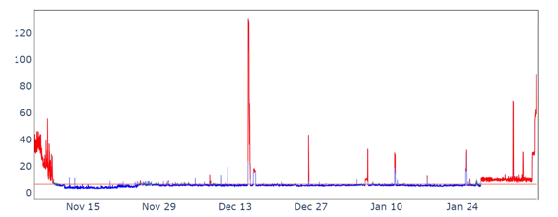
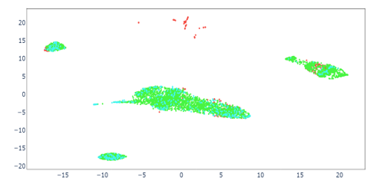
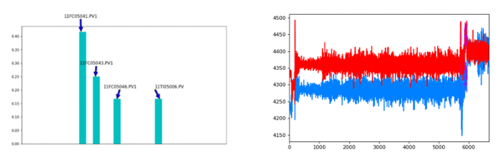
Pyrolysis Reactor
By utilizing the offline model in an online monitoring framework, faults can be detected and feature contribution plots can be created to find the fault contributors.

Slide 41
Fastman-JMP
Show examples
Show sensitivity analysis

Slide 42
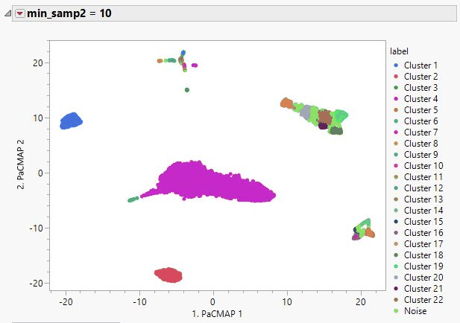
Sensitivity Analysis

